Slide 1
Smart library management system
Thapar university, patiala

Slide 2
Introduction to problem addressed

Slide 3
Problems in current library system
Books are eventually lost in large libraries, if a careless user misplaces it.
Abuse of system
Theft of books
Tearing of pages.
Long queues to borrow and return books
Costly and error prone man power is required.

Slide 4
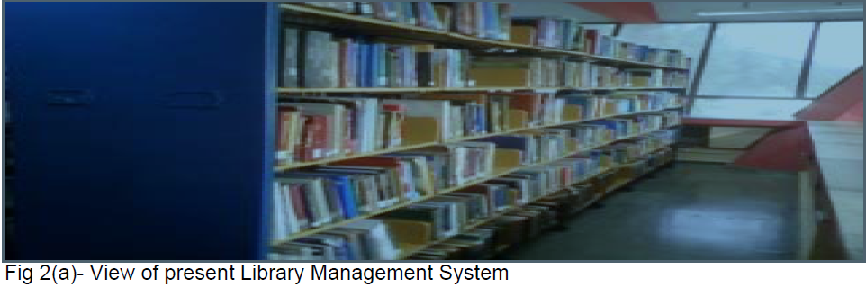
Current library

Slide 5
Possible solution
KEY-IDEA
Real-time tracking books to update the location in database.
POSSIBLES
GPS expensive/ dependence on satellites
Active RFID expensive/ battery in books.
Both of these seems like infeasible, that’s why no one expected a solution of this very crucial problem.
Notes:
Ideas a impossible either in economic or maintainability sense…

Slide 6
OUR IDEA AND DEMONSTRATION

Slide 7
Our IDEA and demonstration – amit
PASSIVE RFID
Put tags on each book and user ID cards
There is a unique ID related to each tag.
GRID arrangement of antennae's
_How they are going to get the location of the books.

Slide 8
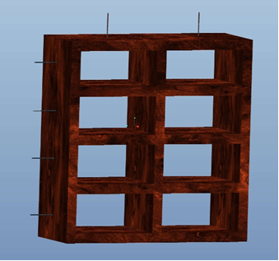
RFID antennae placement

Slide 9
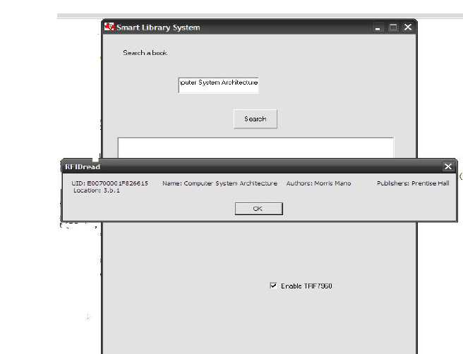
Search interface

Slide 10
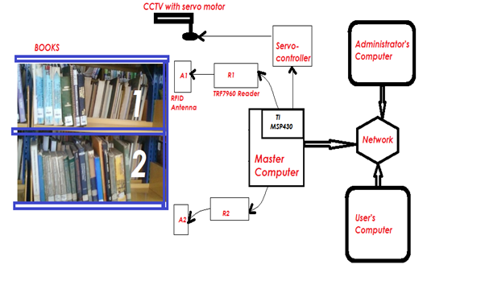
Overall system

Slide 11
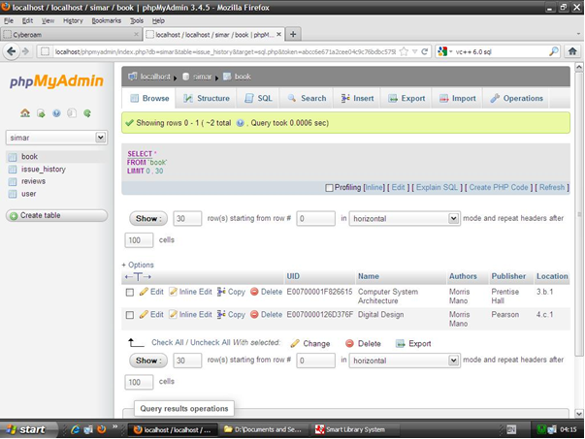

Slide 12
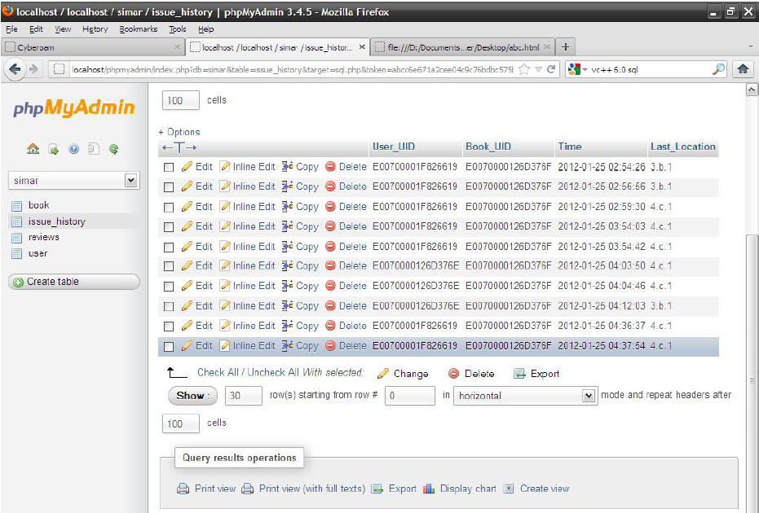

Slide 13
TECHNICAL CHALLENGES/ DETAILS

Slide 14
Technical Details/ Challenges
Hardware
Whether the range of antennae is enough?
What about interference among antennae?
We are using UHF range so minimum interference?
Software
How exactly does software is able to differentiate between users and books?
How does the system know when you remove a book from the RFID?

Slide 15
TRF 7950
Picture of trf 7950
Picture of library shelf clearly showing top and bottom antannaes..

Slide 16
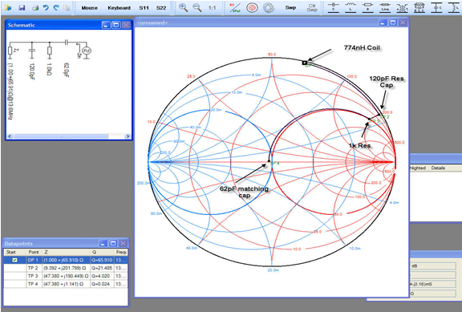
Smith chart - simulations

Slide 17
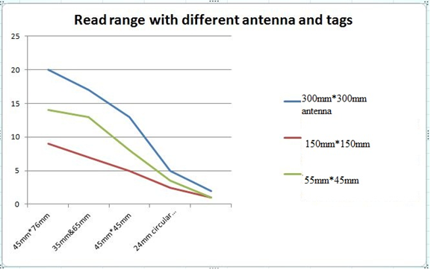

Slide 18
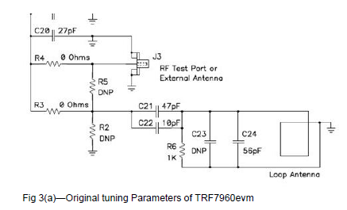
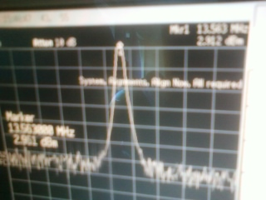
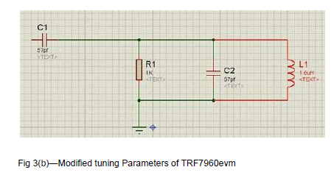
Hardware - Circuits

Slide 19
Software - Mathematical model
Make space for this slide and I will provide the content later..
_Model
Advantages of this model
_how we map the book at any given time
_compare this with the older system
Notes:
This is a very precise and profound description of the system

Slide 20
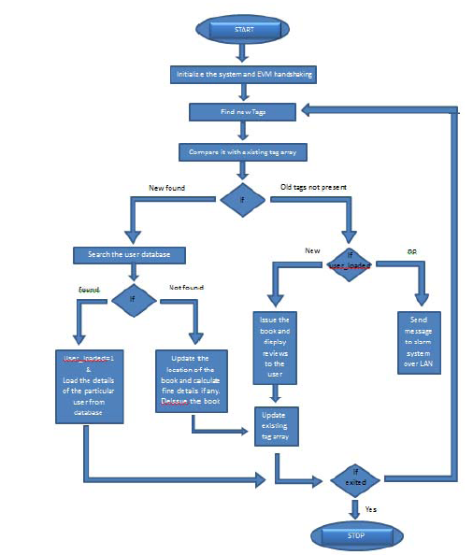
Flowchart
Notes:
Improve the condition of this flow
Possibly include diagrams for visualization of stack or memo (dictionary)

Slide 21
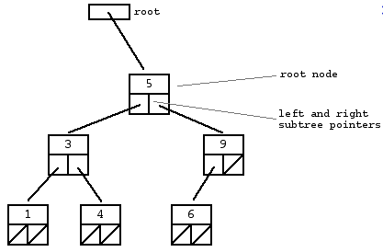
Data structures

Slide 22
Data structures
(“key”, “value”) pairs uniquely identifiable by “key”.
Value may contain set of entries.
These set will act as additional metadata for that “key”.
A Dictionary with a large amount of values.

Slide 23
Data structures
Possible implementations
Binary search tree O(log(n))
Hash table ~O(1)
Possibly to speed up we may use some caching as well.
Cache the users who are more frequent in libraries.
Cache the books which are picked up more frequently.

Slide 24
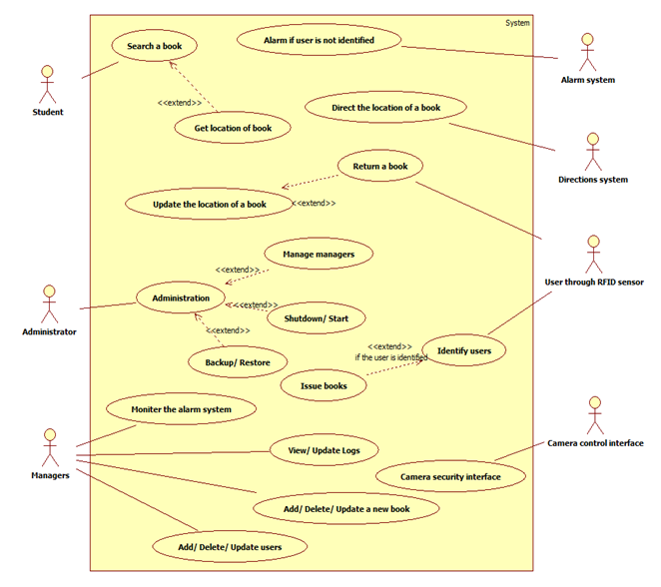
Use case diagram

Slide 25
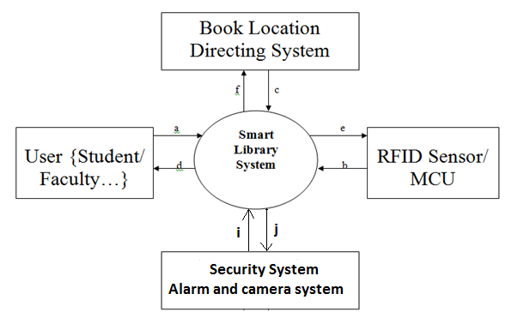
Context free diagram

Slide 26
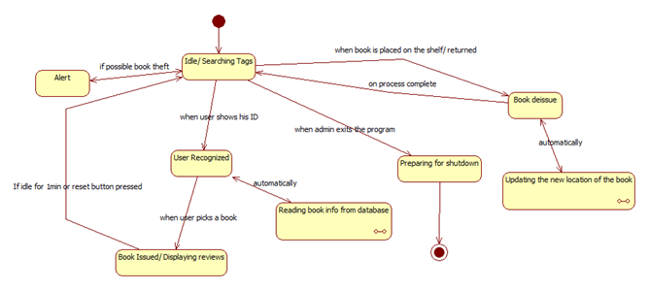
State diagram

Slide 27
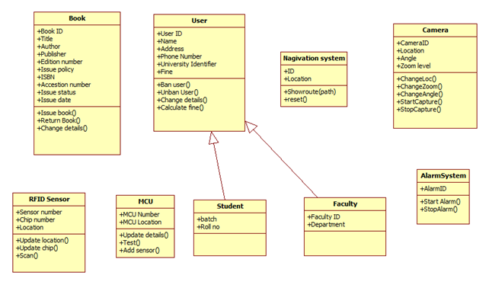
Class diagram

Slide 28
CONCLUSION/ WIND UP

Slide 29
Possible refinements
_Social and economic policies so that users place books are the right location in the first place.
_Placing the books in the right location
_include the new ideas that I though in patent application..
Generalizations (it can be applied to many other systems as well.)
Notes:
wE have enough flexibility by the idea that we are able to map books at any time… so many things can be realised

Slide 30
How far we think we have reached?
Economically very viable solution
_pay off period
_later libraries can use spare money to buy books…
_ no idea about interference among antennas …
So still we need to work out that.
However these is strong hope that this can be worked out.
We have really worked hard so we are sure jury will recognize it.

Slide 31
Thank you accenture yahoo jury members
deepinder
If possible include some references

